Slide 1

Hotel Reservation Analysis with SQL
Ahmad Ali Fatehi Alshaikh Ahmad

Slide 2

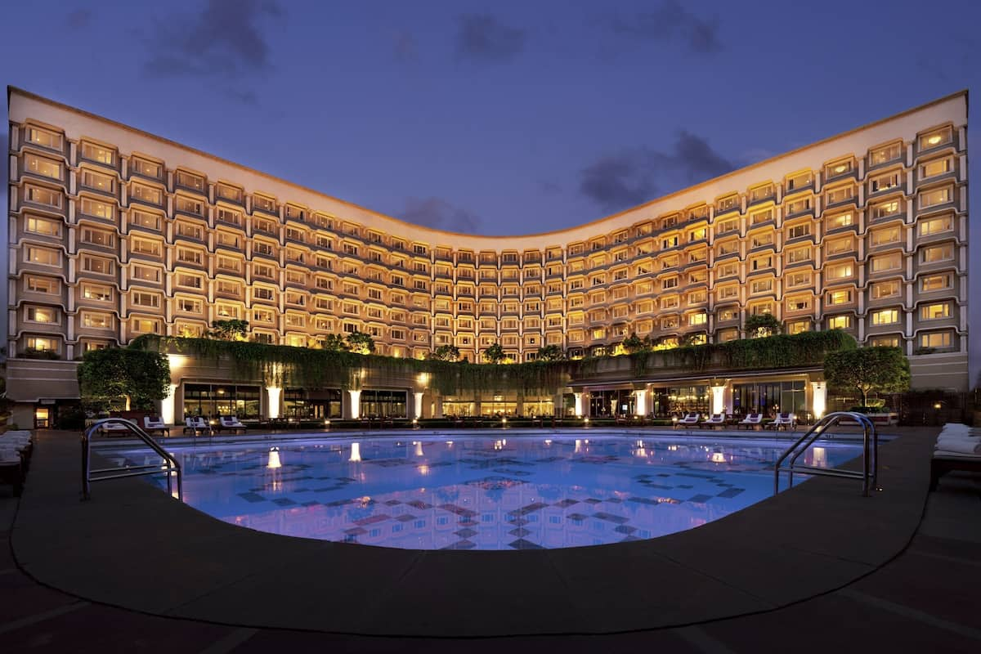
Topic
1.Overview of the datasets
2.Sql query analysis

Slide 3


Introduction
Welcome to our presentation on "Hotel Reservation Analysis: Unveiling Insights Through SQL." In this presentation, we will explore the fascinating world of hotel management data and discover valuable insights using SQL queries

Slide 4
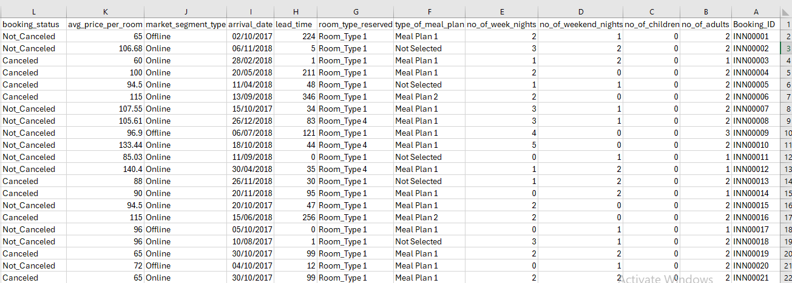
Table

Slide 5


1. Booking ID 2. no of adults 3. no of children 4. no of weekend nights 5. no of week nights 6. type of meal plan 7. room type reserved 8. lead time 9. arrival date 10. market segment type 11. avg price per room 12. booking status
Features

Slide 6

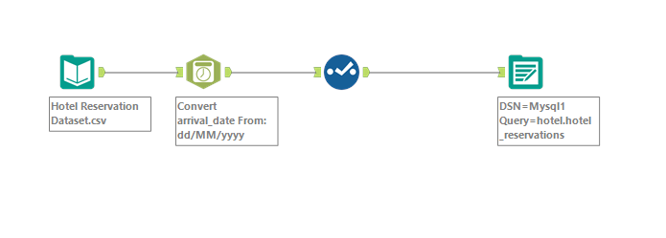
Extract data and load it in dbms Alytrex

Slide 7
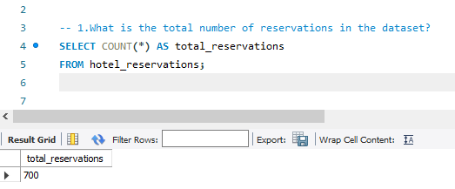
Sql analysis

Slide 8
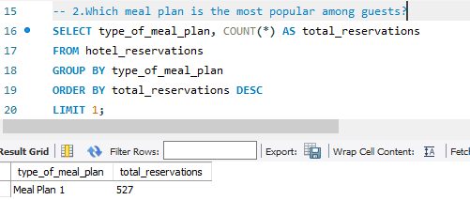
Sql analysis

Slide 9
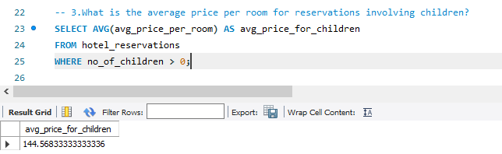
Sql analysis

Slide 10
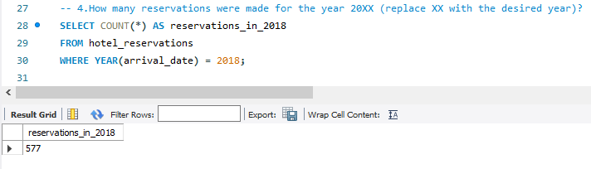
Sql analysis

Slide 11
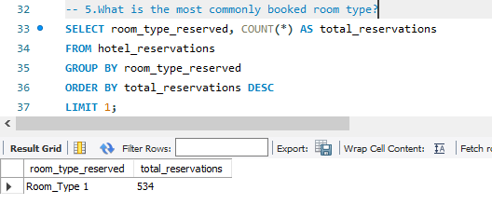
Sql analysis

Slide 12
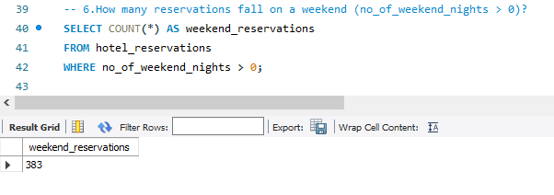
Sql analysis

Slide 13
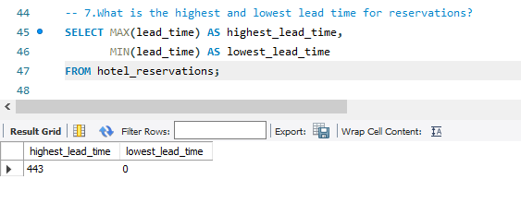
Sql analysis

Slide 14
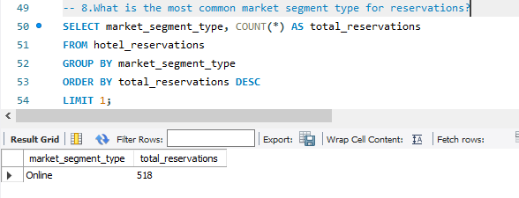
Sql analysis

Slide 15
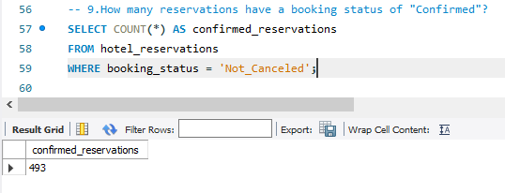
Sql analysis

Slide 16
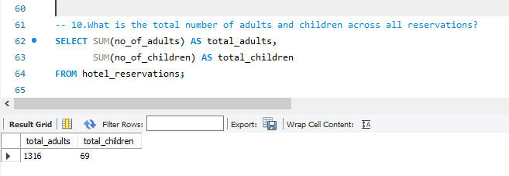
Sql analysis

Slide 17
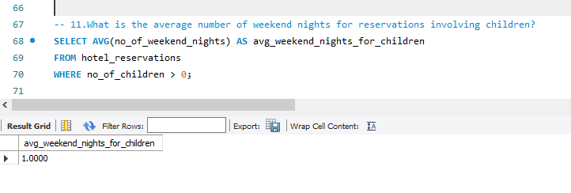
Sql analysis

Slide 18
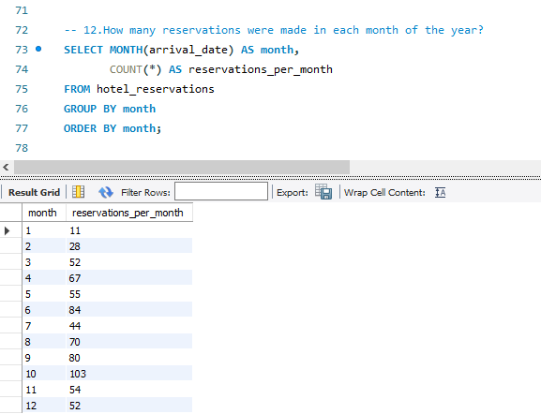
Sql analysis

Slide 19
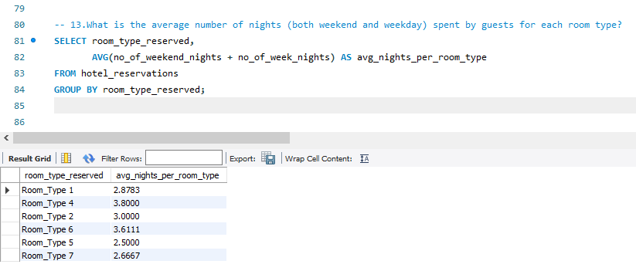
Sql analysis

Slide 20
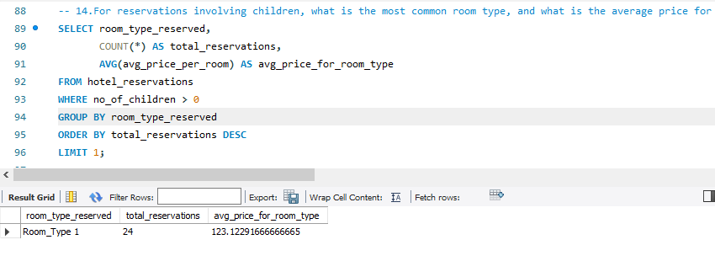
Sql analysis

Slide 21
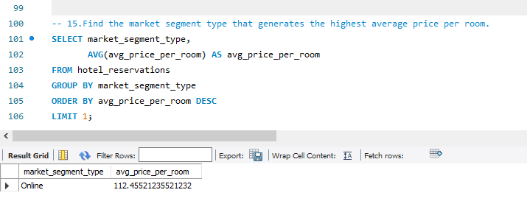
Sql analysis

Slide 22
Content
Summary
SUMMARY
The total of reservation 700
Meal plan 1 most popular meal
Good average price per room for children 145
In year 2018 have the most reservation
The room type 1 is the most commonly room type booked
383 reservations fall on a weekend
the highest lead time for reservations is 443 and the lowest is 0
the most common market segment type is online
493 reservations have a booking status of "Confirmed"

Slide 23
Content 2
Summary
summary
summary
The total number of adults is 1316 and children 69 across all reservations
The average number of weekend nights for reservations involving children is 1
Show the reservations were made in each month of the year,in month 10 was the highest and in month 1 was the lowest
the average number of nights (both weekend and weekday), room type 4 is the highest
Room type 1 is the most common room type, and 123 is the average price for that room
The online market segment type is the highest average price per room

Slide 24



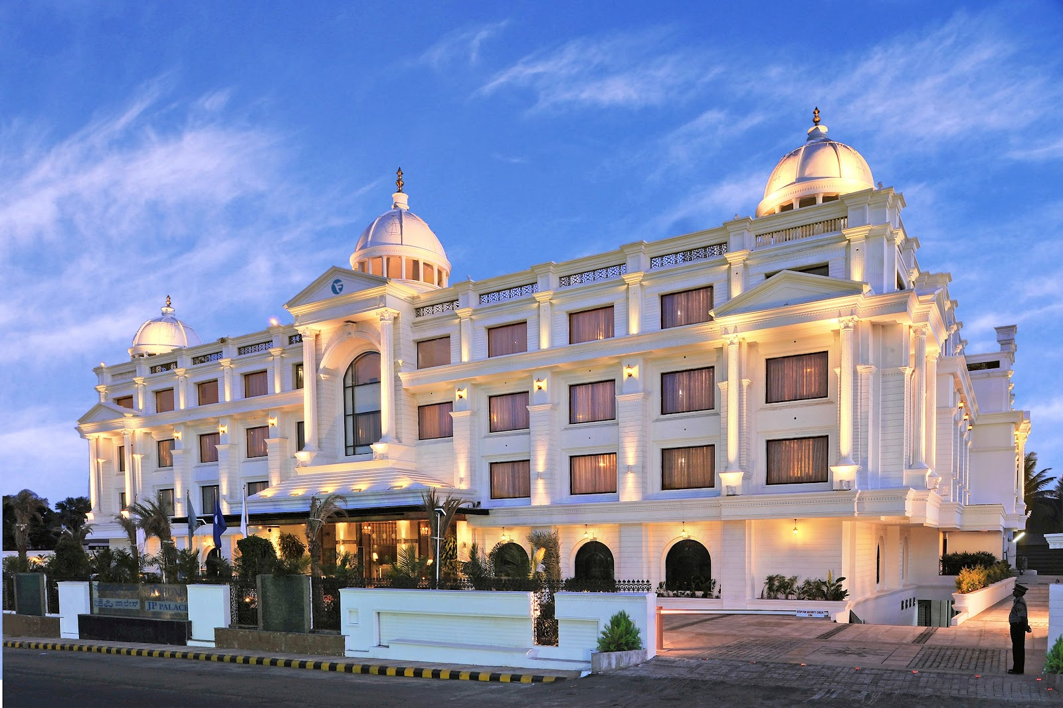
Summary
In conclusion, analyzing hotel policy data with SQL provides valuable insights into guest preferences, booking patterns and market dynamics. These insights can inform strategic decision making, marketing strategies, and operational improvements, ultimately contributing to the success and profitability of the hotel industry. Going forward, continued research and adaptation to changing guest preferences will be essential to sustain competitiveness in the hospitality industry.

Slide 25

Thank you

